Slide 1

UNIT
DAY 13
01
CUT & REBUILD
GAMES OF LOGIC
AGENDA
REMINDERS
Phones into The Holding Cell
Laptops, Lab 1-11, your prototype
What Today Is
What You Hand In
How It Is Marked
Finding The Fix
Pick One Route
The Work, In Order
Checklist
RECOMMENDED LISTENING:
ALABASTER ICELANDS 1 – POKEMON LEGENDS ARCEUS

Slide 2
WHAT TODAY IS
You make the fix you chose on Day 12, then you start building the digital version
Criterion C is already underway, and today, we continue it
How much you get done today decides how much of a headless chicken you are later

Slide 3
WHAT YOU HAND IN TODAY
Update your design production plan to include the production timeline for the final version of the product
Folder slide 25 - today’s changes, with reasons, including which route you picked and why
Folder slide 26 - whatever exists of the artifact. A link, or screenshots, even if it is ugly
  The fix you chose on Day 12 should be actually made today
Neither folder slide has to be finished today, but I should be able to see changes to both of them

Slide 4
HOW TODAY IS MARKED
Criterion C, strands ii, iii and iv. Nothing closes today
Strand ii is technical skill, judged on how complex the work is and how much help you needed
Strand iii is whether the thing works, and whether you followed the plan on folder slide 22
  Asking me a question costs you nothing, but sitting stuck for twenty minutes costs you your time
The full scale is on your Criterion C rubric sheet

Slide 5
FINDING THE FIX IN YOUR NOTES
Take a few minutes to process your data from the playtest last time
"It was confusing" is a complaint, but "Three of the four asked what the wildcard did" is data
Feel free to ask clarifying questions to the players
You should already have one changed planned from last time, and that should be the first thing you modify about your game

Slide 6
PICK ONE ROUTE
Both are valid. Pick one, then write which route and why on folder slide 25
 | PRINT-AND-PLAY PDF | BROWSER BUILD
Tools | Figma, Canva, even Slides | Scratch, or p5.js if you are feeling brave
Good if | your game is cards, tiles and a board | your game needs hidden information or randomness
Difficulties | print margins. Test-print one page before you do forty | Making too much of a ‘video game’ and not a party game

Slide 7
WHAT EACH ROUTE NEEDS FROM YOU
Print-and-play: one PDF, page size set before you export, cards that survive printing at 100 per cent
  Print one test page before you make forty or something
Browser build: it has to open from a link on somebody else’s machine, with no setup
Either way: the rules sheet goes with it
  Even a digital build should have a physical rules sheet
The constraints still apply: 54 components, one page of rules, three minutes to teach

Slide 8
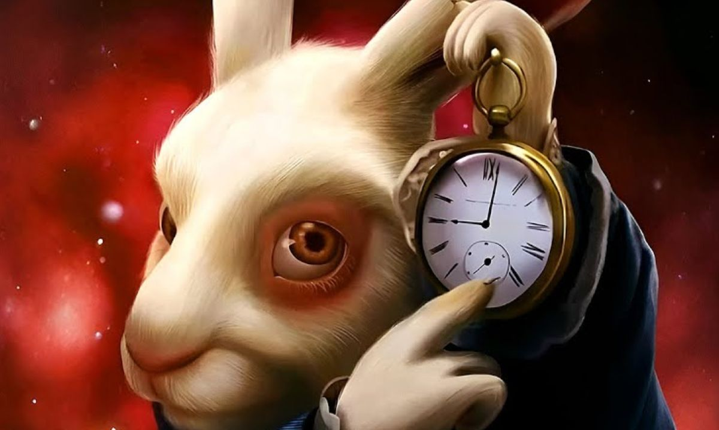
WHILE YOU ARE BUILDING
Make the fix from Day 12 first, before you change anything else
Update your production plan to include your steps for the final build over the next two days
Log every change on folder slide 25 as you go, not at the end
Screenshots onto folder slide 26 as you get them, even the ugly ones
Ask me things. It is, quite literally, what I am here for

Slide 9
WHAT GOES ON SLIDES 25 AND 26
Folder slide 25 - one row per change: the date, what changed, and why
Which route you picked and why is a row. So is the Day 12 fix
Folder slide 26 - the link if you have one, and screenshots either way
If nothing works yet, screenshot the thing not working. That is still evidence you were here
→ FOLDER SLIDES 25 AND 26

Slide 10
THE WORK, IN ORDER
0:20 to 0:32 - make the Day 12 fix, before anything else
0:32 to 1:12 - build, in the route you picked, logging as you go
1:12 to 1:20 - folder slide 25 rows, and whatever exists onto folder slide 26

Slide 11
IF YOU MISSED TODAY
This one is entirely doable alone. Nothing today needs the room
1. Read Lab 1-11 from Tuesday and make the fix you wrote in Q4
2. Pick print-and-play or browser, and write the choice and the reason on folder slide 25
3. Build. Log every change on folder slide 25 as you go
4. Screenshots onto folder slide 26, working or not
Come to the next lesson with a thing that opens. It does not have to be finished, it has to exist

Slide 12
CHECKLIST BEFORE YOU LEAVE
Folder slide 25 - today’s changes, with reasons. Including which route you picked and why
Folder slide 26 - whatever exists of the artifact. A link, or screenshots, even if it is ugly
If nothing works yet, put up a screenshot of the thing not working. That is still evidence you were here
Next time:
Ship it. The artifact is finished, the changes log gets justified, and you write your own test plan for the second playtest

